Slide 1
Introduction
Who am i?
Notes:
Good morning/ afternoon
My name is Avi Nissim – Hart and I am a trainee IT Consultant from London working at QA consulting.

Slide 2
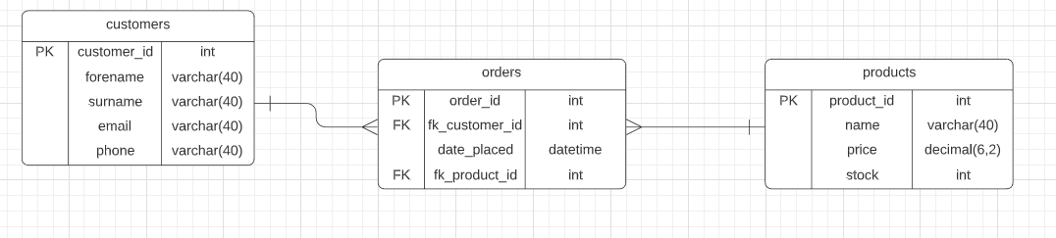
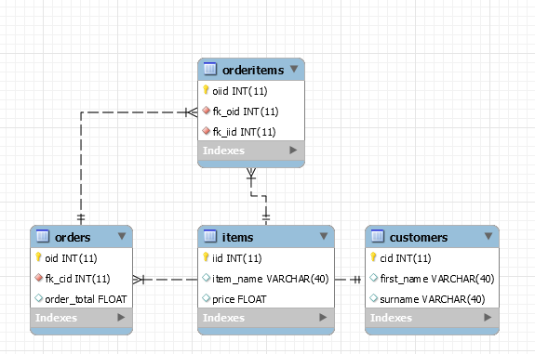
My approach
Product Specification
Notes:
Upon receiving the product specification, I started planning out in my head how I wanted to go about doing this project.
Despite this, my plans changed every time we were taught a new topic or skill that would help us with the implementation.
For example, I initially thought that my database would only consist of 3 tables. Customers, Items, and Orders but it turned out that I would need another table to hold items associated with specific orders.
I started out by making a risk assessment and making some user stories based on the specification to a new project sprint board on my Jira. I also designed an ERD for how I thought my tables would connect. As you can see, I have it next to my final one so you can see the differences.

Slide 3
My Journey
What technologies have I learned for this project?
- SQL
- Java
- Git / GitHub
- Maven
- Junit Testing
Notes:
From the beginning of my training, I have been taught a variety of technologies, principles, and concepts which have all prepared me to complete this project.
We spent a lot of time with Shafeeq learning how to use MySQL databases and how to use queries and tables correctly in a manner that would work for our projects.
We also spent a lot of time learning Java and its many uses and principles. Of course, this was crucial as the project was to be implemented in java. Through this we learnt about Maven and how maven projects can be used for testing purposes as well as Junit tests within.
Most importantly, we learnt how to use Git in order to help us utilise our GitHub repositories. This was important as we used GitHub as our version control and it is important to learn good practice of github from an early stage as we will need to use these skills when collaborating on projects in the future.

Slide 4
CI
How did I set up my Continuous Integration Pipeline?
- Regular Commits and Pushes to Feature Branch
- Merging to dev branch when satisfied
- Repository: https://github.com/AviNissimHart/IMS-Starter
Notes:
Admittedly, my understanding of the Continuous integration pipeline was rather hazy to begin with, but as I worked on the project, it seemed to all come together in my head and I managed to understand the concepts of it.
The way in which I ensured continuous integration, already having the maven project in my eclipse, was by setting up my git repository with different branches (forking one from the trainer), having a sprint board of all my user stories and tasks to do, and having testing ready. I was able to go through each task on my sprint board and build it in my code. Upon completing it (or fixing any mistakes), after pushing commits to my feature branch, I would then merge the branch with my dev branch. After this I would switch to my dev branch and pull so that my dev branch was up to date with my latest version. Then I would switch back to my feature branch and start tackling the next feature to implement from my sprint board. I repeated this for all major changes throughout my implementation. At the very end, I merged my dev branch into my master branch for my final product with a .jar file that included dependencies.

Slide 5
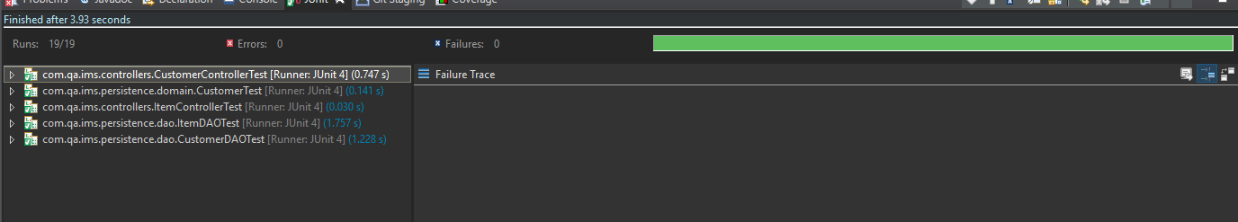
Testing
- Coverage
- Static analysis
- Red-green-refactor
Notes:
When it came to my testing, I managed to get everything working perfectly up until the OrderDAO test which I shall explain further into this presentation, due to an unknown error with my foreign keys – despite the program working as it was intended.

Slide 6
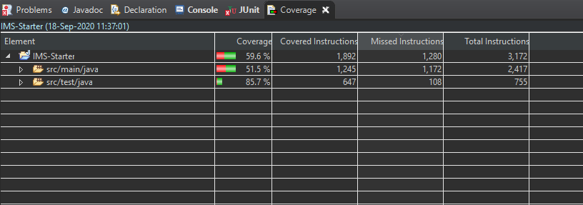
Coverage
Notes:
As you can see, despite the issues I faced, my test coverage was still pretty good so I know that I am pleased with my ability to test what was possible.

Slide 7
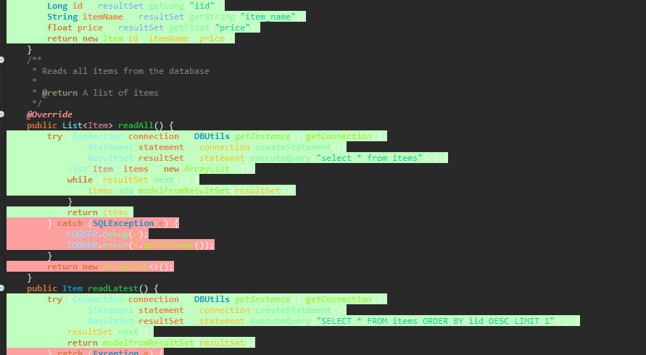
Red-Green-Refactor
Notes:
As you can see, my coverage was mostly green. The customer instances were completely green. I found this tool interesting and useful to help me see where issues were coming from within my code. Above is a snippet from my itemDAO class. Unfortunately, as will be explained, my order instances were all red due to the unknown issue. This being said, I am still very pleased with the progress that I made and it is good to see my code coming up in green.

Slide 8
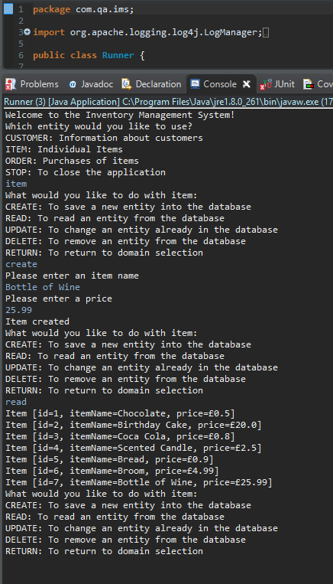
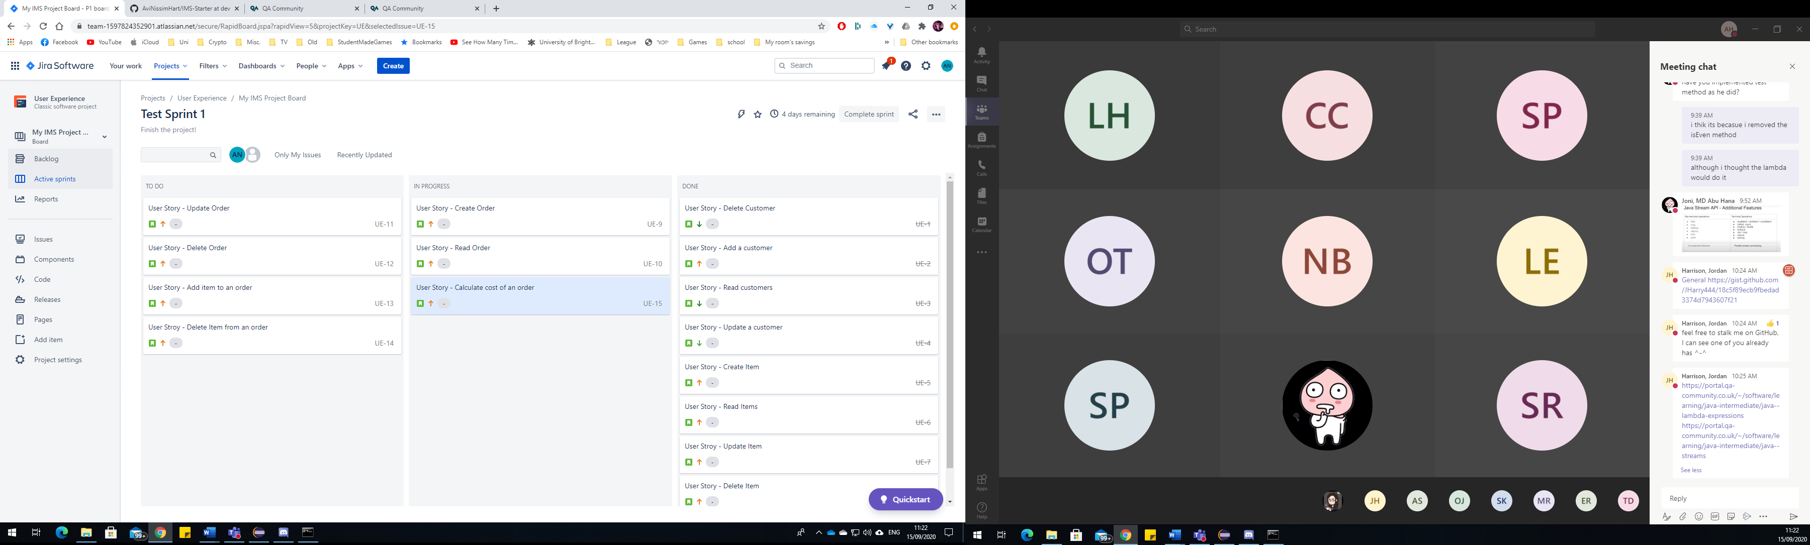
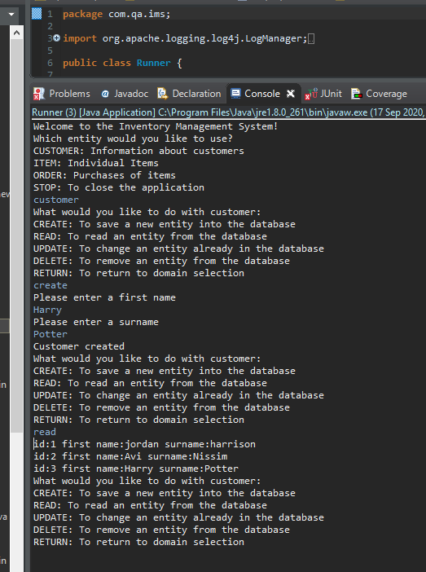
Demonstration
A couple of user stories e.g. create customer and create item
Notes:
Here I have a screenshot of my sprint board while it was in progress as well as an example of me creating a customer and creating an item (followed by reading customers and items to show the creation)
As you can see in the first example, I created a customer named harry potter and then proceeded to read all the customers together and the new customer has been added
For the second example, I have added bottle of wine with a price of 25.99 and done the same to read the items

Slide 9
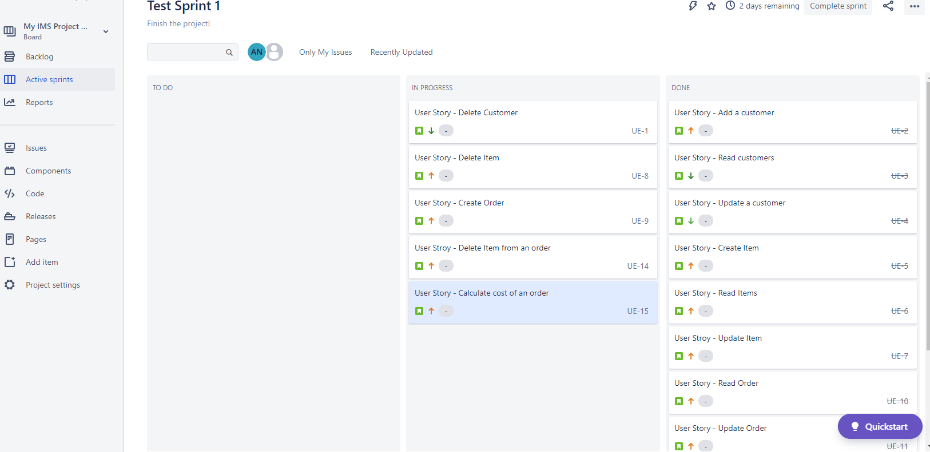
My Project Management Board
Notes:
Here is a better View of my Project Management Board with my sprint of all the features I had to implement. This was taken near the end as I had to revise some of the features to fix them.

Slide 10
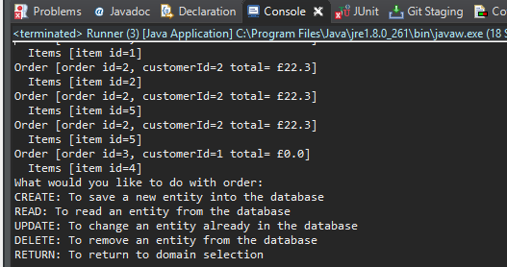
Creating an Order
Prior to an unknown mishap at the end, I was able to sufficiently create and read orders as shown below.
Notes:
I had this working very well to begin with, but unfortunately, due to tweakings during the testing, there was a discrepancy with the foreign keys which neither myself or my trainer could seem to get to the bottom of.
For this reason, I know that next time, I will need to model my database more carefully in regard to the foreign key constraints as well as focusing more on some of the SOLID principles which would help to prevent these issues.
But otherwise, I could create an order and not have it show upon reading the orders until it actually contained some items. Therefore, I would need to create an order (which wont display when reading orders) and then adding an item to the order for it to display when reading the orders again.

Slide 11
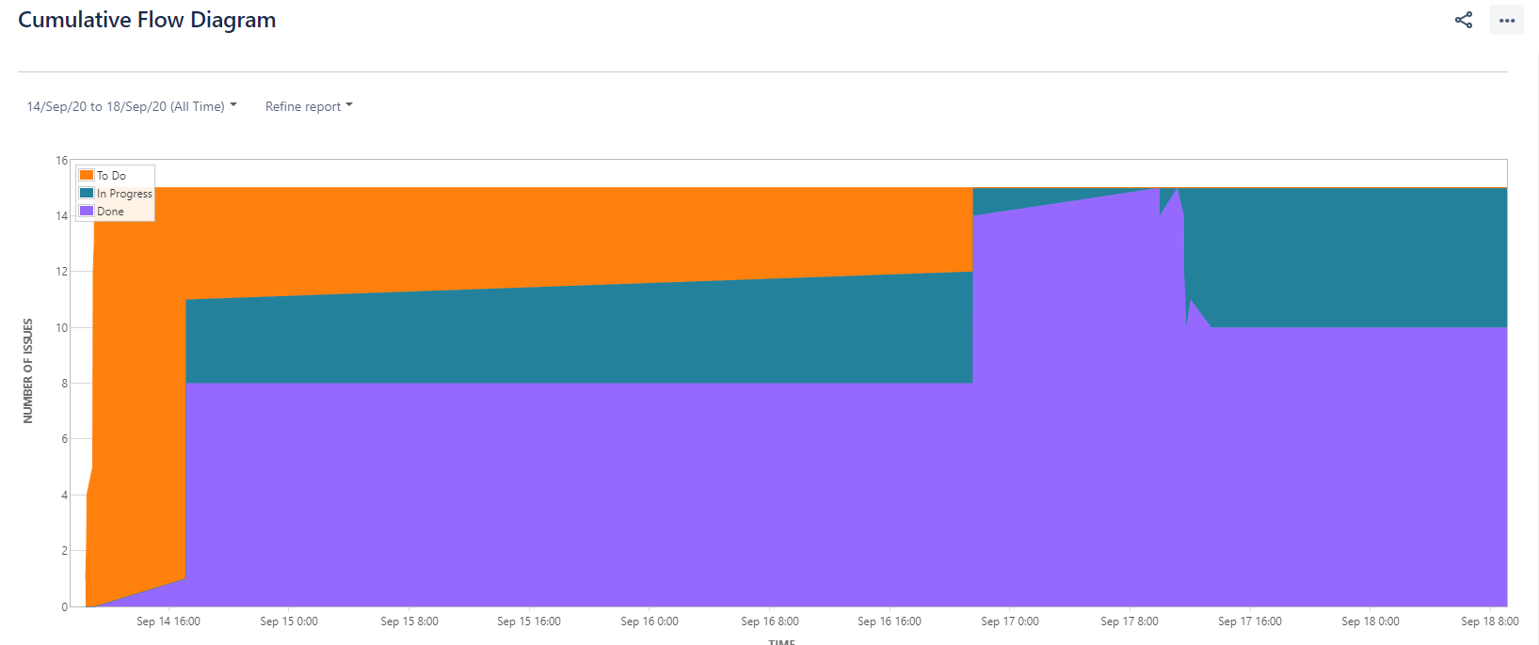
Sprint Review
What was completed and what was left behind?
Notes:
As you can see above, I have a couple of screenshots from my sprint. I successfully implemented all the features desired for the project, but as I went along, I found myself breaking previous features due to the nature of the new features and how I would implement them. Therefore, I had to leave out the calculation feature as I could not implement it successfully into my code without destroying the functionality of the other features. Again, better adherence to the Single responsibility principle could have prevented this, but that is a major lesson I have learnt from this project.
Additionally, despite the program working fine, it output some error messages for an unknown reason before providing the desired results in the console. For this reason, I had to leave the OrderDAOTest behind as it would prevent the project from being packaged appropriately in a .jar file.

Slide 12
Sprint Retrospective
What went well and what can be improved?
- SOLID Principles
- Database preparation
- Testing
- Successful implementation of most of the features
Notes:
In retrospect, I am very pleased with the progress I made with the majority of the project including features I implemented but did not end up using e.g. the calculate function.
I feel that I learnt a lot by doing all this and I now have a better understanding of what I would do differently next time.
To improve, I would need to model my database better from the very beginning to avoid any issues when changing its functionality at a later date. I would need to ensure that I work better in adherence to the solid principles – specifically the single responsibility principle as a lot of my issues stemmed from trying to make different methods work with each other rather than just having each one implemented and using them in other places by calling them when needed.
Overall, I am still very pleased with the progress that I have made.

Slide 13
Conclusion
- Reflections on project
- Future steps
Notes:
Overall, I am very proud of my first project and how I managed to make the majority of it work as intended. I feel that I have learnt a lot from my mistakes – from which I will be sure to tackle future projects better by ensuring that the areas I realise require correction are adhered to. Such as enforcing the SOLID principles on my development in a much stricter fashion.
I feel that completing this project is a major milestone in my journey in programming and it has changed the way in which I now perceive a large project in regard to the code structures and how I will proceed to take it on.

Slide 14
Questions
Any questions?
Notes:
Thank you very much for listening, does anybody have any questions?

